Slide 1
Tan Ratio - Angles
Miss L
Year 12 Essentials

Slide 2
Learning Intentions
Students will be able to
Find the angle of the triangle

Slide 3

Think – Pair - Share
How can we use Trigonometry in the real word?

Slide 4
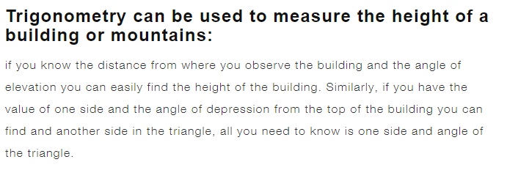
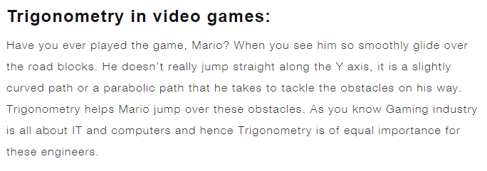
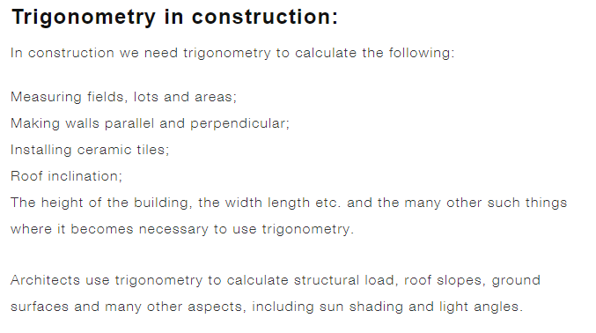
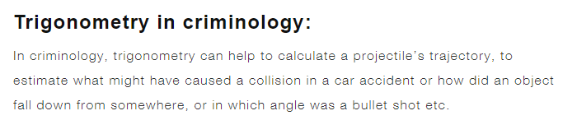
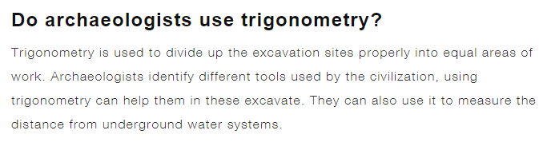

Slide 5
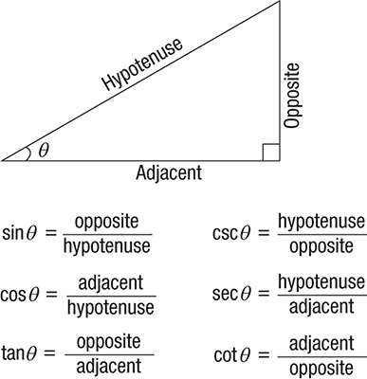
Last Lesson Recap

Slide 6
Finding the Angle
14cm
In this situation we use the _________ formula because we have the Opposite and Adjacent lengths.
ϴ
10cm
Opposite
Adjacent
14
10
1.4
Tanϴ =
=
=
So we know the ratio of the sides but how do we find the angle size?

Slide 7
24
7
30
Trigonometry
Date:
EQ – How do I use the Tan Ratio to find the angle?
What are the inverse of Trig Functions?
To find the size of the angle when we have two sides of a right-angled triangle, we have to use the inverse of the trigonometric function.
The inverse of Sin is Sin⁻¹
Therefore:
For Tan ϴ = O
A
Then ϴ = Tan⁻¹ ( O )
A
The inverse of Cos is _____
The inverse of Tan is Tan⁻¹

Slide 8
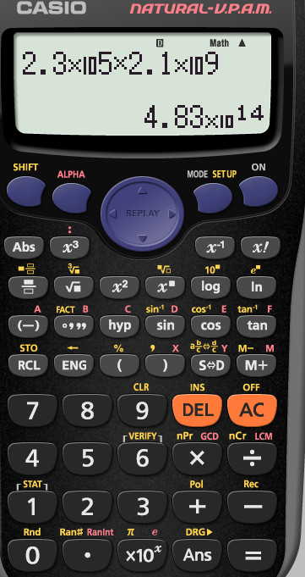
Here is tan ⁻¹

Slide 9
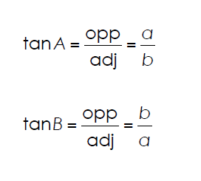
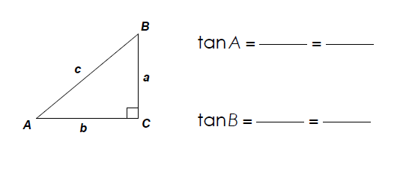
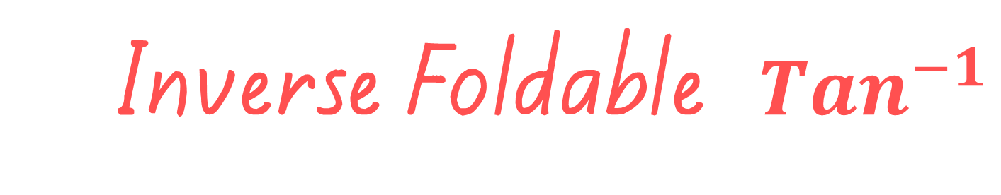
Inverse Foldable ${Tan}^{−1}$

Slide 10
Finding the Angle
Tanϴ = Opposite
Adjacent
Tanϴ = 14
10
Tanϴ = 1.4
ϴ = Tan ⁻¹ (1.4)
ϴ = 54.46° (degrees)
In this situation we use the tangent formula because we have the Opposite and Adjacent lengths.
14cm
ϴ
10cm

Slide 11


Slide 12
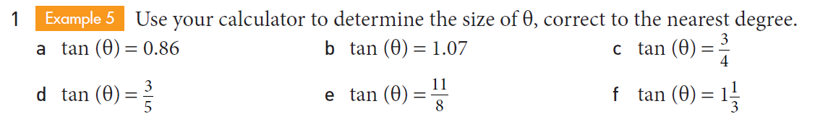
Practice

Slide 13
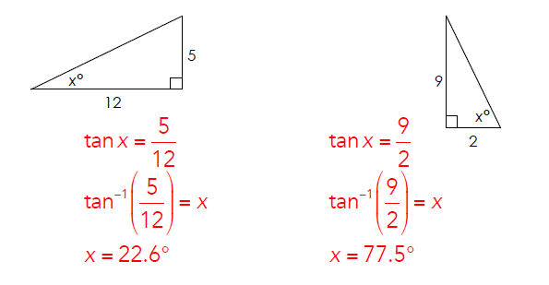
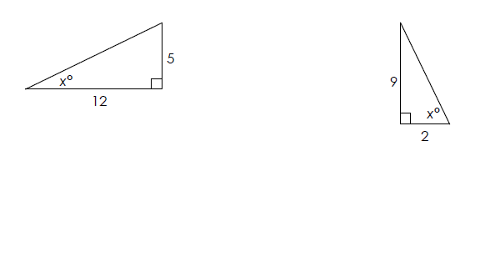
Inverse Foldable ${Tan}^{−1}$

Slide 14
Task
Complete Questions 3 and 4
Page 67 Essentials Book
Complete the exit pass and give to your teacher at the end of the lesson

